Slide 1
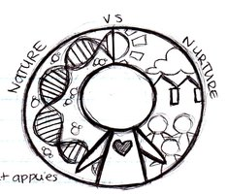
Socialization: Learning Culture
Week 6

Slide 2
The Self and Socialization
Looking-Glass Self
Stages of Self
Preparatory Stage - Symbols
Play Stage - Role Taking
Game Stage - Generalized other
Presentation of self
Impression Management
Dramaturgical Approach

Slide 3
Socialization
Learning Culture
Learning Roles
Role Strain
Role Conflict
What are the main Agents of Socialization?

Slide 4
Agents of Socialization

Slide 5
A job is alright, but what most women really want is a home and children.
Soc 105
Fall 2015

Slide 6
A job is alright, but what most women really want is a home and children.

Slide 7
A job is alright, but what most women really want is a home and children.
Soc 105
54%
Soc 105
12%

Slide 8
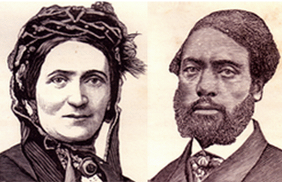
Ellen and William Craft

Slide 9
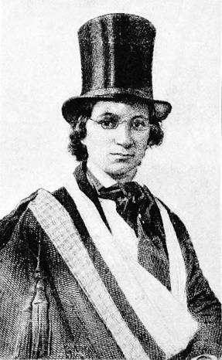
Ellen and William Craft

Slide 10
Socialization and the Life Course
Rites of Passage
Anticipatory Socialization
Resocialization
Total Institutions

Slide 11

Resocialization

Slide 12
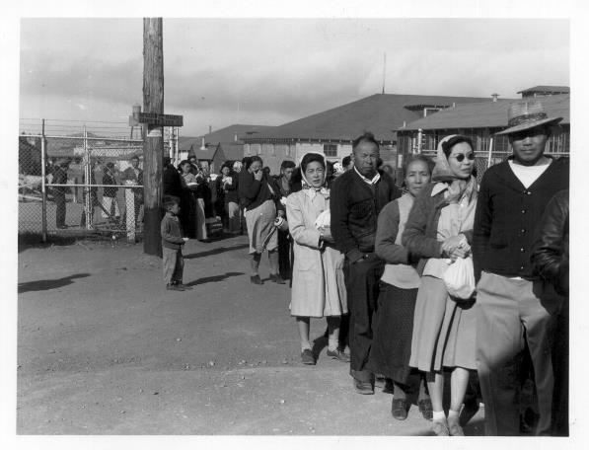
Resocialization
Total Institutions:
Interment Camps
Boot Camps
Prisons
Convents etc.

